Slide 1

Indian Institute of Technology , Patna
Topic : Activation functions
Presented By :
Rutuj Waghare (2111MC10)
M.Tech – Mathematics and Computing
Guided By :
Dr. Prashant Srivastava
Associate Professor
Department of Mathematics
[1]

Slide 2

[2]
source : https://visualstudiomagazine.com

Slide 3
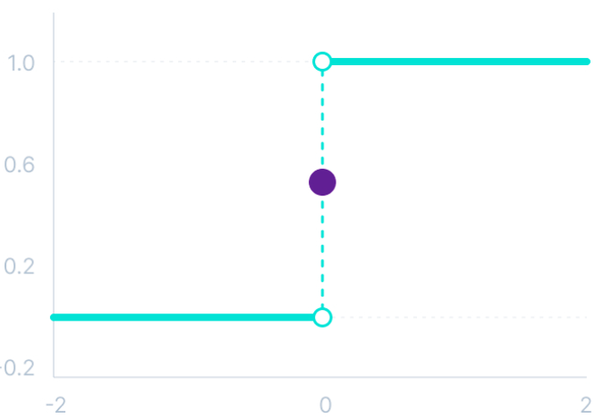
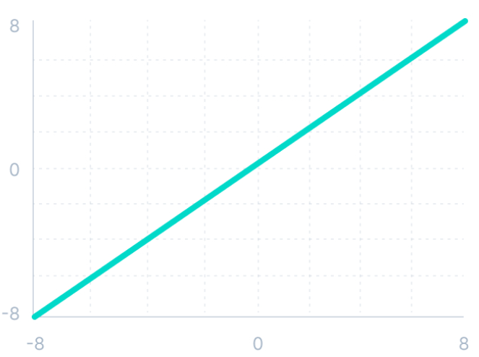
Linear activation function
Binary step function
[3]
source : v7labs.com

Slide 4
Categories of Activation functions
Binary step function
Activation Functions
Linear activation function
Non - Linear activation function
[4]

Slide 5
Non-linear activation functions
They allow backpropagation.
They allow the stacking of multiple layers of neurons.
[5]

Slide 6
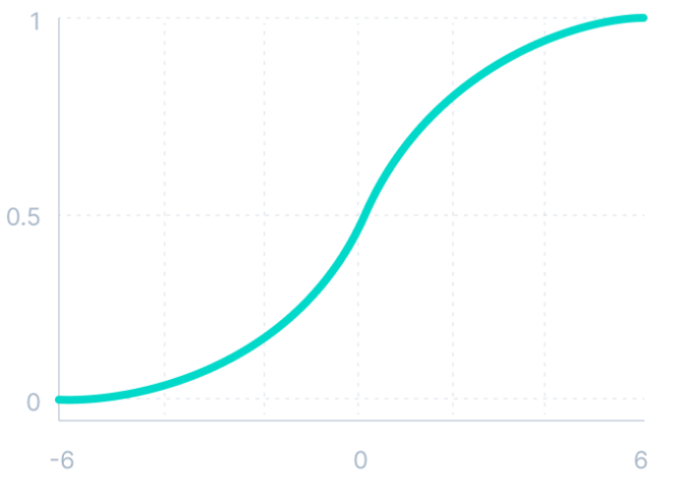
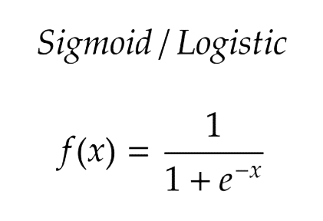
Sigmoid activation function
Mathematically
[6]
source : v7labs.com

Slide 7
It is commonly used for models where we have to predict the probability as an output.
Since probability of anything exists only between the range of 0 and 1, sigmoid is the right choice because of its range.
The function is differentiable and provides a smooth gradient.
[7]

Slide 8
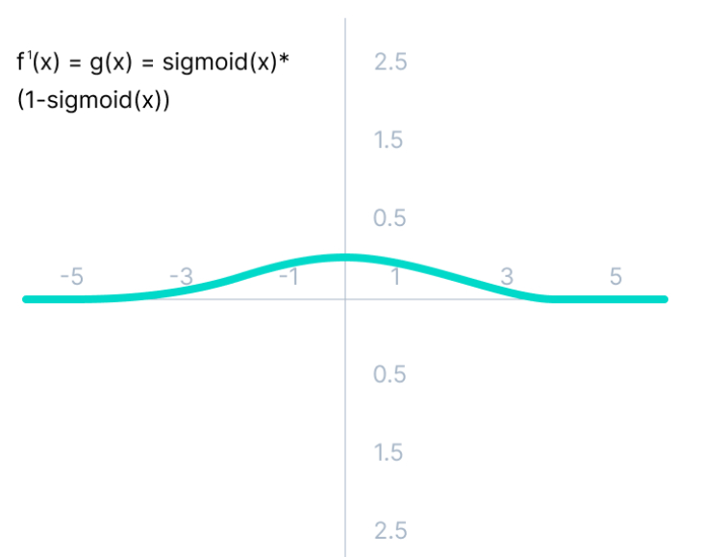
Limitations
[8]
source : v7labs.com

Slide 9
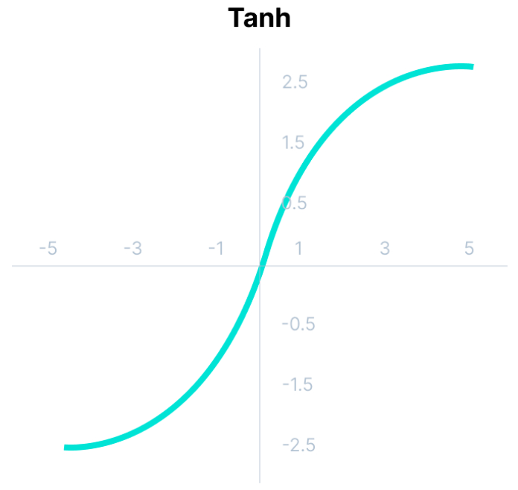
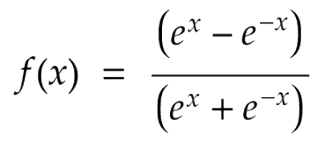
Tanh activation function
Mathematically
[9]
source : v7labs.com

Slide 10
Usually used in hidden layers of a neural network as its values lie between -1 to 1
mean for the hidden layer comes out to be 0 or very close to it.
It helps in centering the data and makes learning for the next layer much easier.
[10]

Slide 11
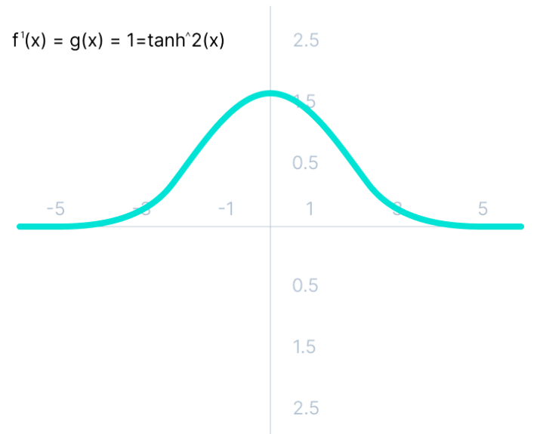
Limitations
[11]
source : v7labs.com

Slide 12
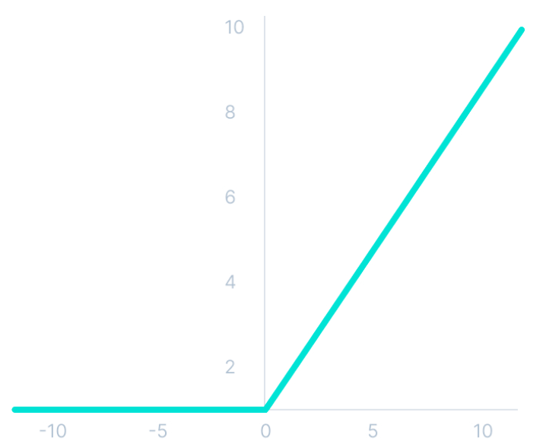
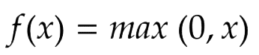
ReLu activation function
Mathematically
[12]
source : v7labs.com

Slide 13
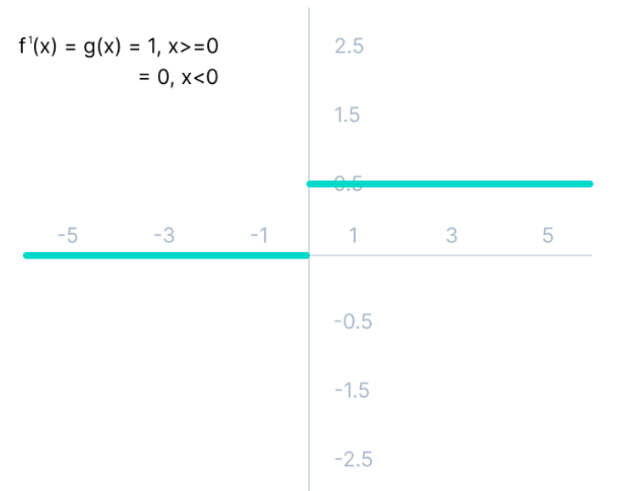
Limitations
[13]
source : v7labs.com

Slide 14
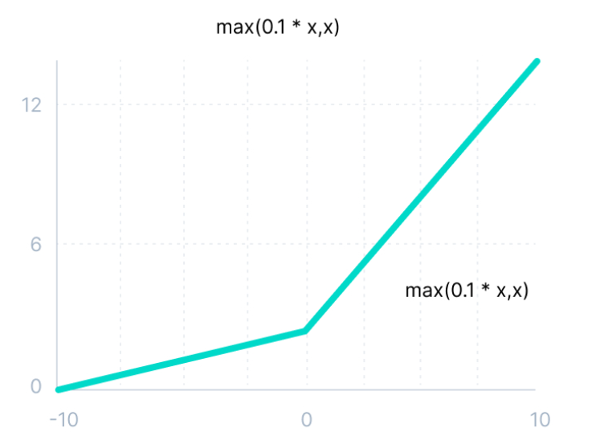
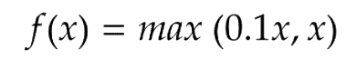
Leaky ReLu activation function
Mathematically
[14]
source : v7labs.com

Slide 15
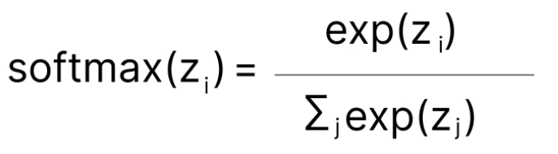
Softmax activation function
[15]
source : v7labs.com

Slide 16
Softmax activation function
0.8
0.9
0.7
0.8
?
[16]

Slide 17
Softmax activation function
1.8
0.58
1
Soft- max
0.9
0.23
0
0.68
0.19
0
[17]

Slide 18
How to choose activation function ?
ReLu activation function should only be used in the hidden layers
Sigmoid and Tanh functions should not be used in hidden layers as they make the model more susceptible to problems during training (due to vanishing gradients).
Swish function is used in neural networks having a depth greater than 40 layers.
[18]

Slide 19
Based on the type of prediction problem that you are solving.
Regression - Linear Activation Function
Binary Classification - Sigmoid Activation Function
Multiclass Classification - Softmax
Based on the type of neural network architecture.
Convolutional Neural Network (CNN) - ReLu activation function.
Recurrent Neural Network (RNN ) - Tanh and/or Sigmoid activation function.
[19]

Slide 20
References
[1] https://ml-explained.com/blog/activation-functions-explained [Accessed on 31 Jan 2022 ]
[2] https://medium.com/the-theory-of-everything/understanding-activation-functions-in-neural-networks-9491262884e0 [Accessed on 31 Jan 2022 ]
[20]

Slide 21
Thank You.
[21]

